Slide 1

Car prices Data Analysis – Module 2
Module 2 Deliverable
By
Shobharani

Slide 2
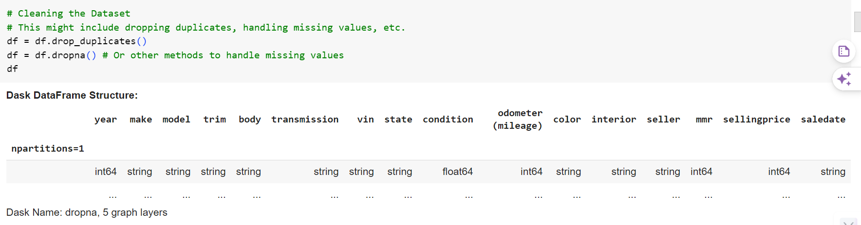
1. Clean the Dataset

Slide 3
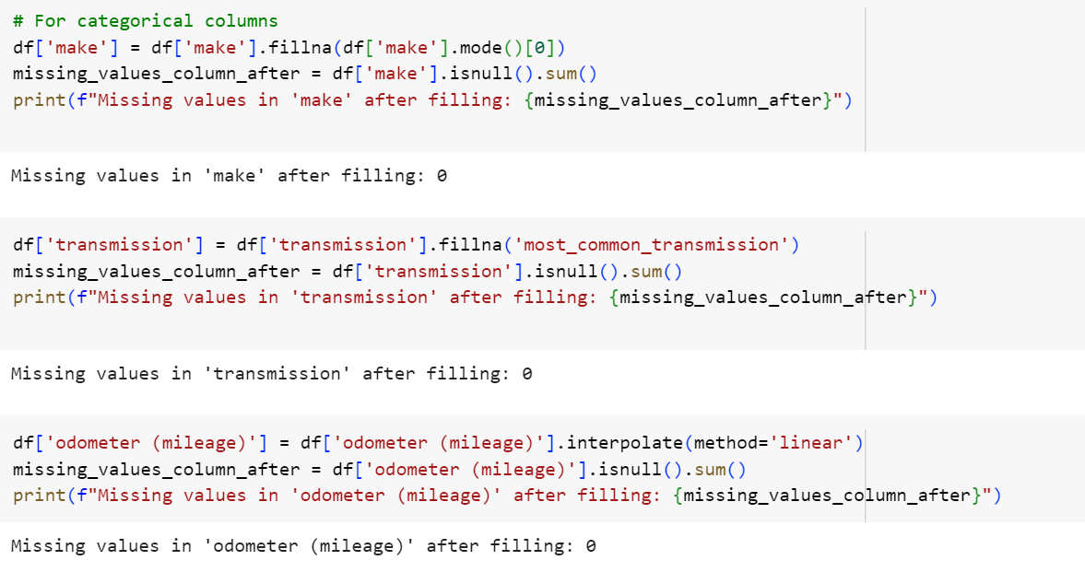
For categorical columns

Slide 4
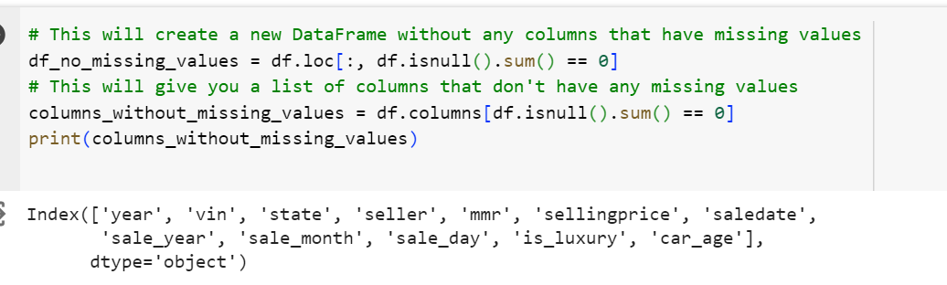
DataFrame to show only columns without any missing values

Slide 5
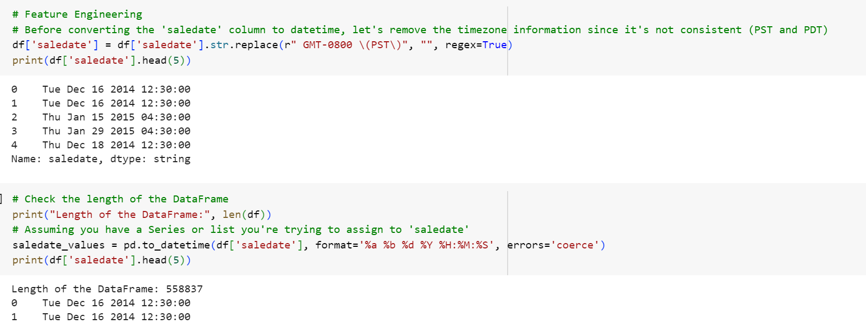
2. Feature Engineer Based off of your experiment Transformation
Performed Date

Slide 6
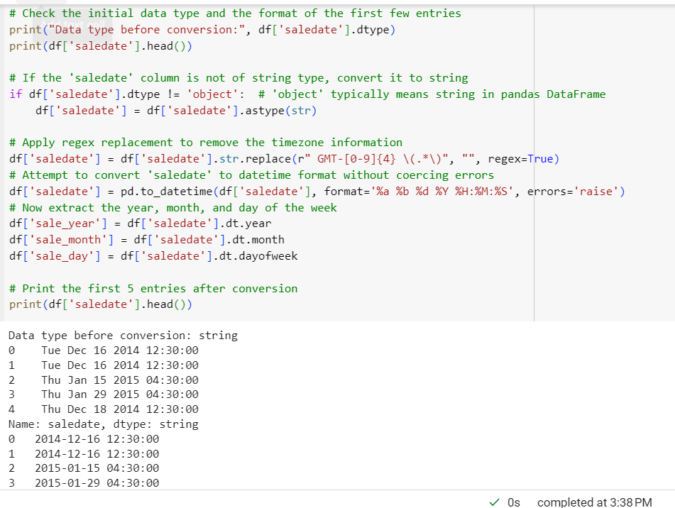
Data type before conversion

Slide 7
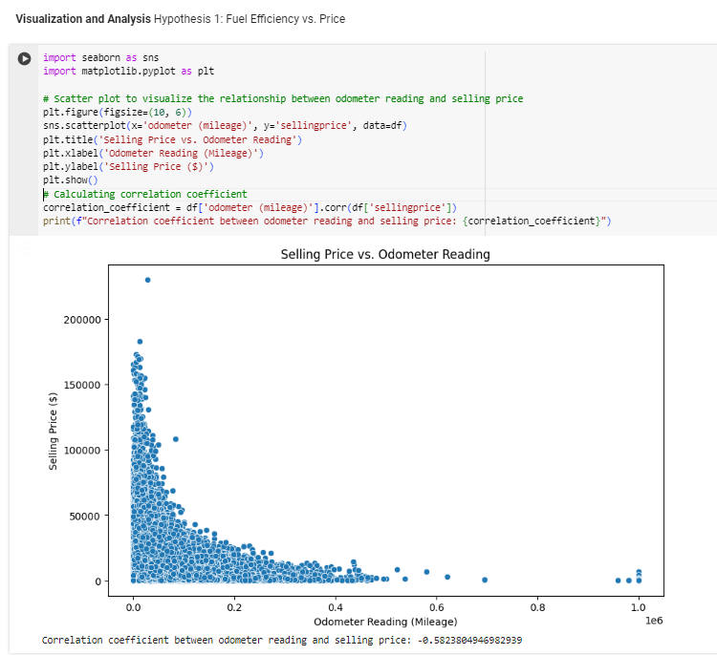
Perform EDA Based off of your Hypotheses

Slide 8
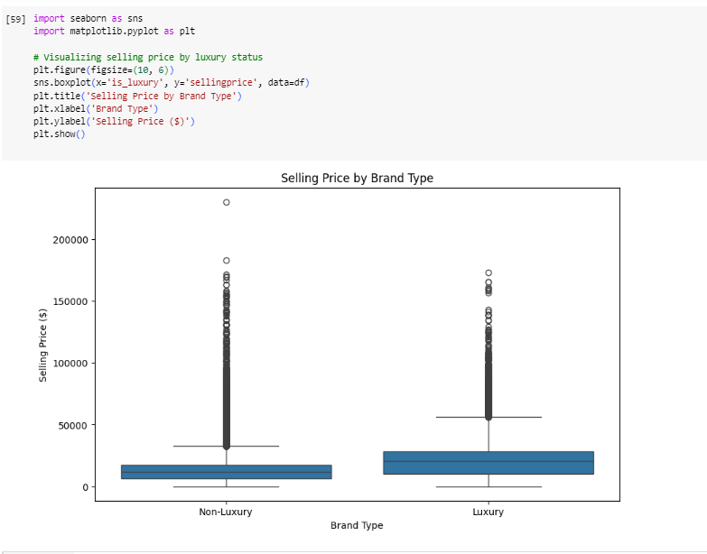
Hypothesis 2: Luxury vs. Non-Luxury Brand Prices

Slide 9
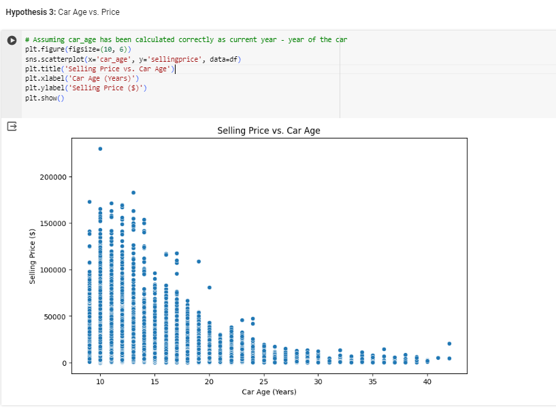
Hypothesis 3: Car Age vs. Price

Slide 10
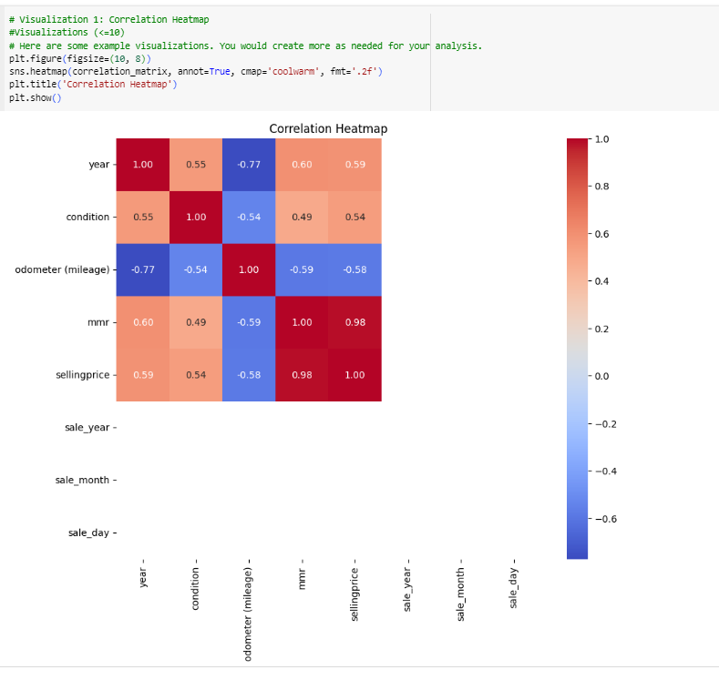
Have <=10 Visualizations : Visualization 1: Correlation Heatmap

Slide 11
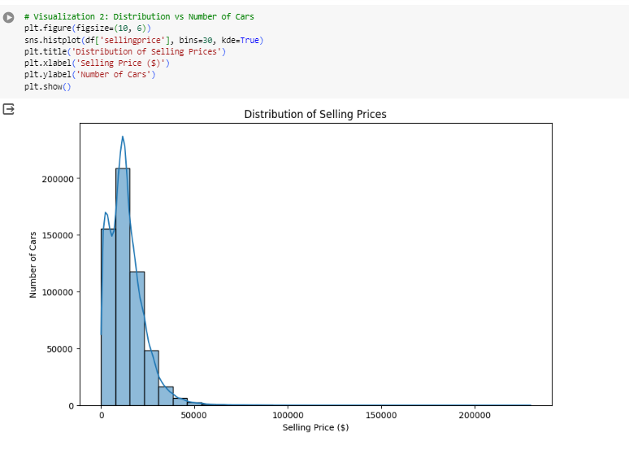
Visualization 2: Distribution vs Number of Cars

Slide 12
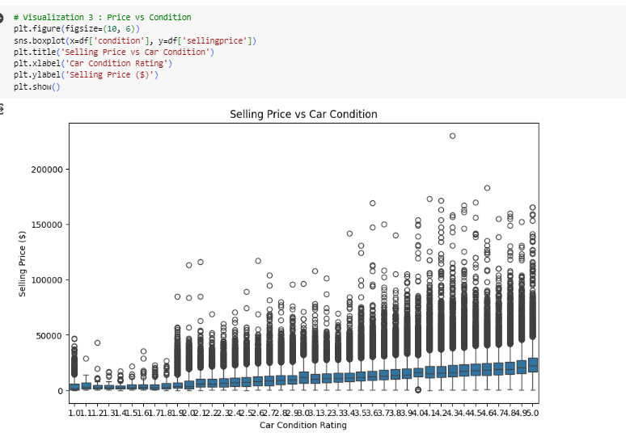
Visualization 3 : Price vs Condition

Slide 13
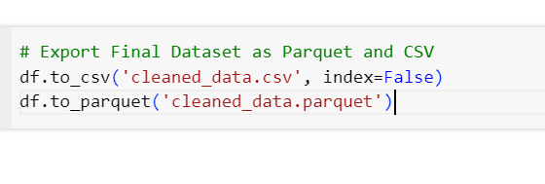
4. Export Final Dataset as Parquet and CSV

Slide 14

Thank you

